Slide 1

Python Essentials
Introduction to Python Essentials

Slide 2
Introduction to Python Essentials
In this Tutorial we are going to Cover –
Introduction
Python Basics
Python Flow Control
Python Functions
Python Datatypes
Python File Handling and Exception
Python Class and Objects
Python Miscellaneous
Etc.
Notes:
Functional programming supports partially applied functions, currying, support for first class functions and closures.

Slide 3
Python Essentials
Overview of Python

Slide 4
Python Essentials
Getting Started with Anaconda

Slide 5
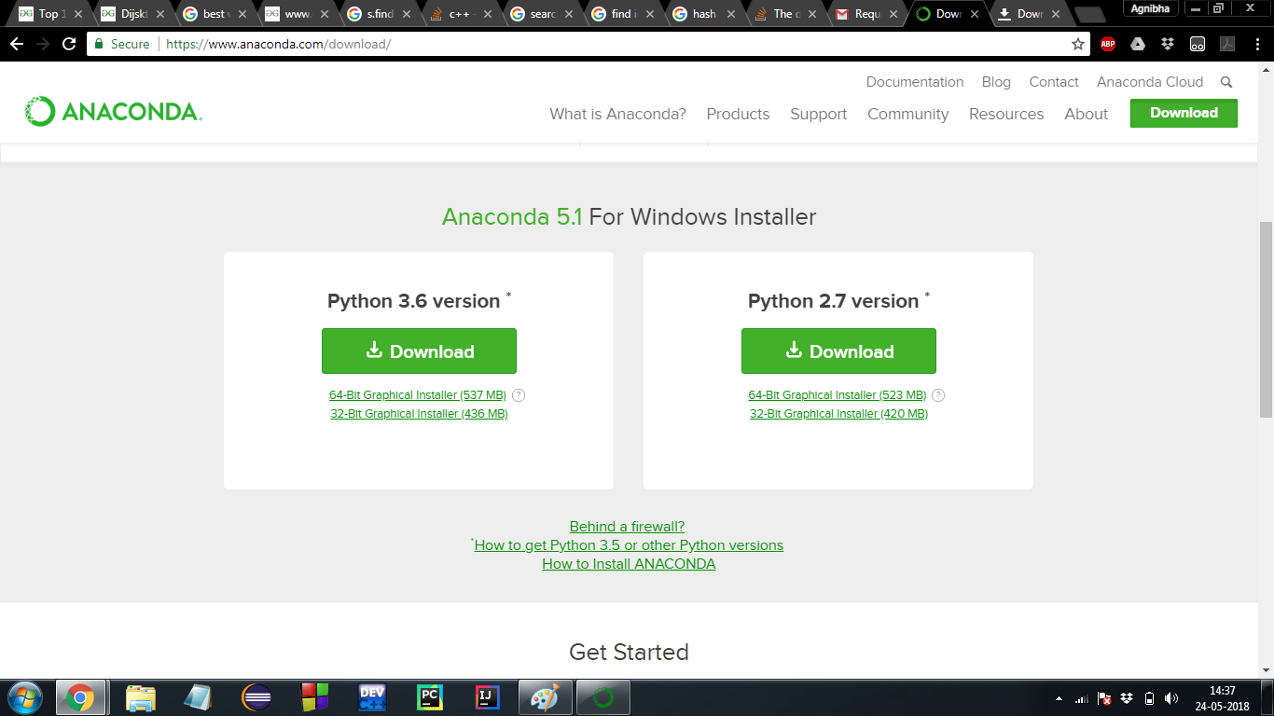
Getting Started with Anaconda
Anaconda download link –
https://www.anaconda.com/download/

Slide 6
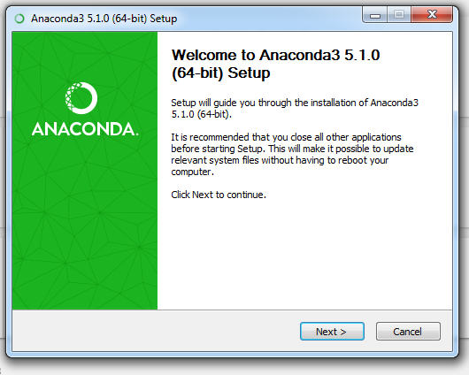
Getting Started with Anaconda

Slide 7
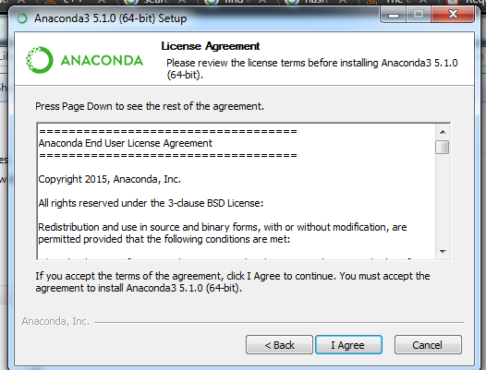
Getting Started with Anaconda

Slide 8
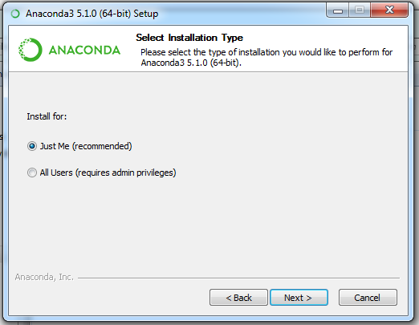
Getting Started with Anaconda

Slide 9
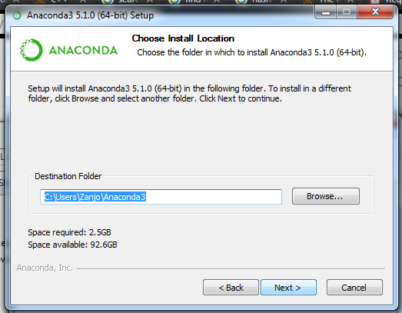
Getting Started with Anaconda

Slide 10
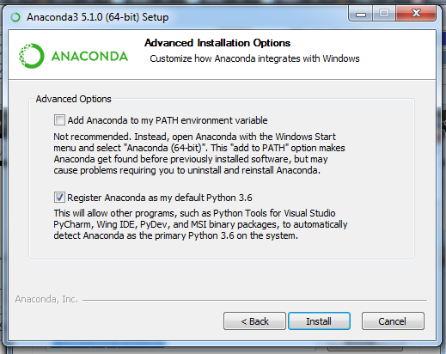
Getting Started with Anaconda

Slide 11
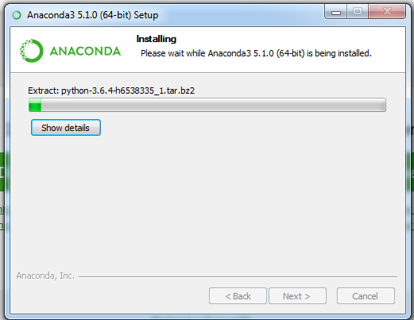
Getting Started with Anaconda

Slide 12
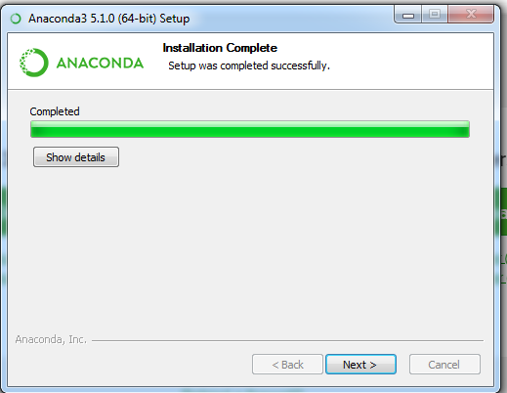
Getting Started with Anaconda

Slide 13
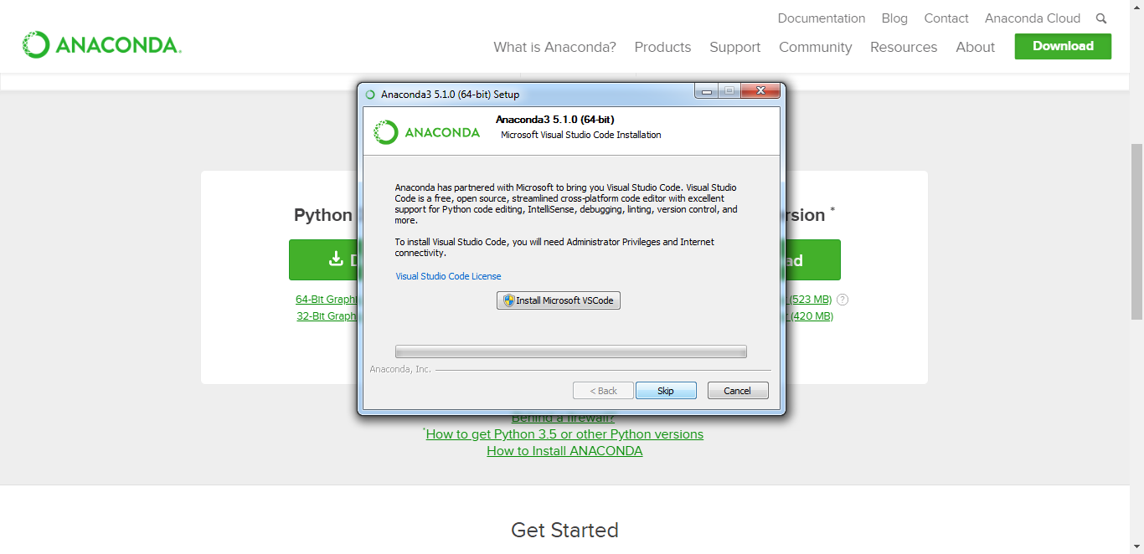
Getting Started with Anaconda

Slide 14
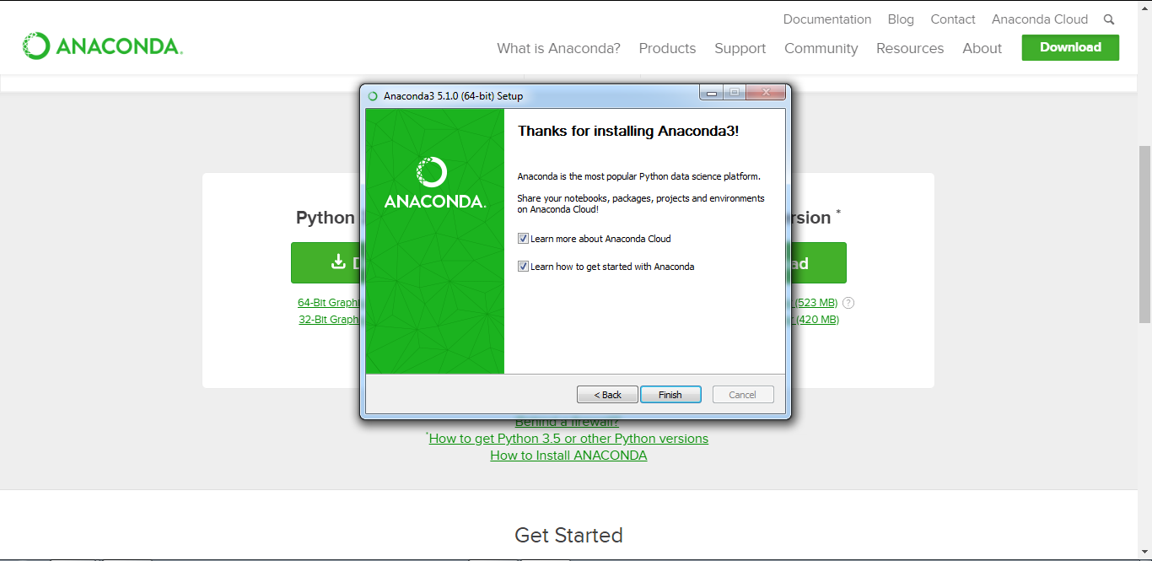
Getting Started with Anaconda

Slide 15
Python Essentials
Python Keywords & Identifiers

Slide 16
Python Keywords and Identifiers
Python Keywords –
Keywords are the reserved words in Python.
During coding keywords can’t be used as variable name, function name or any other identifier. They are used to define the syntax and structure of the Python language.
Keywords are case sensitive in Python.

Slide 17
Python Keywords and Identifiers
List of Python Keywords –
False | class | finally | is | return
None | continue | for | lambda | try
True | def | from | nonlocal | while
and | del | global | not | with
as | elif | if | or | yield
assert | else | import | pass
break | except | in | raise

Slide 18
Python Keywords and Identifiers
Python Identifier – Identifier is nothing but the names given to entities like class, functions, variables etc. in Python. It helps us in differentiating one entity from another.
Rules for writing identifiers:
Identifiers can be a combination of letters in lowercase (a to z) or uppercase (A to Z) or digits (0 to 9) or an underscore (_). Names like myClass1, var_2 and display_to_screen, all are valid example.
An identifier cannot start with a digit. 1variable is invalid, but variable1 is perfectly fine.
Keywords cannot be used as identifiers.
We cannot use special symbols like !, @, #, $, % etc. in our identifier.
Let us go for a demonstration…

Slide 19
Python Essentials
Python Statements & Comments

Slide 20
Python Statements and Comments
Python Statement - Instructions that a Python interpreter can execute are called statements. For example, kount = 10 is an assignment statement. if statement, for statement, while statement etc.
Multi-line statement - In Python, end of a statement is marked by a newline character. But we can make a statement extend over multiple lines with the line continuation character (\). For example:
print(‘Welcome to \
the world \
of programming”)

Slide 21
Python Statements and Comments
Python Indentation – Like other programming languages e.g. C, C++, Java use braces { } to define a block of code. Python uses indentation.
As example:
for i in range(1,10):
for j in range(1,5):
print(i,j)

Slide 22
Python Statements and Comments
Python Comments
In Python, we use the hash (#) symbol to start writing a line comment.
As example:
# this is a line comment

Slide 23
Python Statements and Comments
Multi-line comments –
If we have comments that extend multiple lines, one way of doing it is to use hash (#) in the beginning of each line. For example:
# In this program, we have
# used functions and
# iterations
Another way of doing this is to use triple quotes, either ''' or """.
These triple quotes are generally used for multi-line strings. But they can be used as multi-line comment as well. Unless they are not docstrings, they do not generate any extra code. As example:
'''This is a
multiline comment'''

Slide 24
Python Statements and Comments
Docstring in Python –
Docstring is short for documentation string.
It is a string that occurs as the first statement in a module, function, class, or method definition. We must write what a function/class does in the docstring.
Let us go for a demonstration…

Slide 25
Python Essentials
Python Variables and Constants

Slide 26
Python Variables
In Python variable is a named location used to store data in the memory. Each variable must have a unique name called identifier.
In Python, variables do not need declaration to reserve memory space. The "variable declaration" or "variable initialization" happens automatically when we assign a value to a variable.
As example:
kount = 100
emp_name = "Robin“
age1, age2, age3 = 44, 37, 22

Slide 27
Python Constants
A constant is a type of variable whose value cannot be changed. It is helpful to think of constants as containers that hold information which cannot be changed later.
Naming conventions for variables and constants in Python:
Nomenclature should be purpose
Use camelCase notation
Use capital letters to represent a constant
Symbols like @, #, !, $ % etc. should not be used
Don’t start with a digit
Constants are put into Python modules and meant not be changed.
Constant and variable names should have combination of letters in lowercase (a to z) or uppercase (A to Z) or digits (0 to 9) or an underscore (_).
Let us go for a demonstration…

Slide 28
Python Essentials
Python Different Datatypes

Slide 29
Python Different Datatypes
Each value in Python has got a datatype. Following is the list of some important datatypes:
Python Numbers
Python List
Python Tuple
Python Strings
Python Set
Python Dictionary
Also in Python conversion between datatypes are possible.

Slide 30
Python Essentials
Python Datatype Conversion and Type Casting

Slide 31
Python Datatype Conversion & Type Casting
Datatype Conversion in Python:
The process of converting the value of one data type (integer, string, float, etc.) to another data type is called type conversion. Python has two types of type conversion.
Implicit Type Conversion
Explicit Type Conversion
Let us go for the demonstration…

Slide 32
Python Essentials
Python Input, Output and Import

Slide 33
Python Input, Output and Import
Some of the functions like input() and print() are widely used for standard input and output operations respectively.
When our program grows bigger, it is a good idea to break it into different modules.
For the ease of program development, definitions inside a module can be imported to another module or the interactive interpreter in Python. We use the import keyword to do this.
Let us go for the demonstration…

Slide 34
Python Essentials
Python Operators

Slide 35
Python Operators
Operators are special symbols in Python that carry out arithmetic or logical computation. The value that the operator operates on is called the operand.
In Python operators can be classified as below:
Arithmetic operators
Comparison operators
Logical operators
Bitwise operators
Assignment operators
Special operators
Identity operators
Membership operators

Slide 36
Python Operators
Arithmetic Operators in Python:
Operator | Meaning | Example
+ | Add two operands or unary plus | x + y, +2
- | Subtract right operand from the left or unary minus | x – y, -2
* | Multiply two operands | x * y
/ | Divide left operand by the right one (always results into float) | x / y
% | Modulus - remainder of the division of left operand by the right | x % y (remainder of x/y)
// | Floor division - division that results into whole number adjusted to the left in the number line | x // y
** | Exponent - left operand raised to the power of right | x**y (x to the power y)

Slide 37
Python Operators
Comparison Operators in Python:
Operator | Meaning | Example
> | Greater that - True if left operand is greater than the right | x > y
< | Less that - True if left operand is less than the right | x < y
== | Equal to - True if both operands are equal | x == y
!= | Not equal to - True if operands are not equal | x != y
>= | Greater than or equal to - True if left operand is greater than or equal to the right | x >= y
<= | Less than or equal to - True if left operand is less than or equal to the right | x <= y

Slide 38
Python Operators
Logical Operators in Python:
Operator | Meaning | Example
and | True if both the operands are true | x and y
or | True if either of the operands is true | x or y
not | True if operand is false (complements the operand) | not x

Slide 39
Python Operators
Bitwise Operators in Python:
Operator | Meaning | Example
& | Bitwise AND | x & y
| | Bitwise OR | x | y
~ | Bitwise NOT | ~x
^ | Bitwise XOR | x ^ y
>> | Bitwise right shift | x >> 2
<< | Bitwise left shift | x << 2

Slide 40
Python Operators
Assignment Operators in Python
Operator | Example | Equivatent to
= | x = 2 | x = 2
+= | x += 2 | x = x + 2
-= | x -= 2 | x = x – 2
*= | x *= 2 | x = x * 2
/= | x /= 2 | x = x / 2
%= | x %= 2 | x = x % 2
//= | x //= 2 | x = x // 2
**= | x **= 2 | x = x ** 2
&= | x &= 2 | x = x & 2
|= | x |= 2 | x = x | 2
^= | x ^= 2 | x = x ^ 2
>>= | x >>= 2 | x = x >> 2
<<= | x <<= 2 | x = x << 2

Slide 41
Python Operators
Special Operators: Identify Operators in Python
Operator | Meaning | Example
is | True if the operands are identical (refer to the same object) | x is True
is not | True if the operands are not identical (do not refer to the same object) | x is not True

Slide 42
Python Operators
Special Operators: Membership Operators in Python
Operator | Meaning | Example
in | True if value/variable is found in the sequence | 2 in x
not in | True if value/variable is not found in the sequence | 2 not in x
Let us go for the demonstration…

Slide 43
Python Essentials
Python Namespace and Scope

Slide 44
Python Namespace and Scope
Namespace in Python –
In Python namespace is a collection of names. which holds as a mapping of every name, we have defined, to corresponding objects.
Different namespaces can co-exist at a given time but are completely isolated.
A namespace containing all the built-in names is created when we start the Python interpreter and exists as long we don't exit.

Slide 45
Python Namespace and Scope
Namespace in Python (Contd.) –
Modules can have various functions and classes. A local namespace is created when a function is called, which has all the names defined in it. Similar, is the case with class.
Let us go for a demonstration…
Built-in Namespace
Module: Global Namespace
Function: Local Namespace

Slide 46
Python Essentials
Python if…elif...else

Slide 47
Python if…elif...else
Python if Statement Syntax:
if test expression:
statement(s)
Python if Statement Flowchart
Test Expression
False
True
Body of if

Slide 48
Python if…elif...else
Python if...else Statement Syntax:
if test expression:
Body of if
else:
Body of else
Python if..else Flowchart
Test Expression
False
True
Body of if
Body of else

Slide 49
Python if…elif...else
Python if...elif...else Statement Syntax:
if test expression:
Body of if
elif test expression:
Body of elif
else:
Body of else
Test Expression of if
False
True
Test Expression of elif
False
Body of if
True
Body of elif
Body of else

Slide 50
Python if…elif...else
Python Nested if statements:
We can have a if...elif...else statement inside another if...elif...else statement. This is called nesting in computer programming.
Indentation is the only way to demark the level of nesting.
Let us go for a demonstration…

Slide 51
Python Essentials
Python Iterations Using For

Slide 52
Python Iterations Using For
For loop syntax in Python:
The for loop in Python is used to iterate over a sequence (list, tuple, string) or other iterable objects. Iterating over a sequence is called traversal.
for val in sequence:
Body of for
For each item in sequence
Last item reached?
Yes
No
Body of for
Exit Loop

Slide 53
Python Iterations Using For
The range() function:
We can generate a sequence of numbers using range() function. range(10) will generate numbers from 0 to 9 (10 numbers).
We can also define the start, stop and step size as range(start, stop, step size). step size defaults to 1 if not provided.

Slide 54
Python Iterations Using For
For loop with else section:
A for loop can also have an optional else block. The else part is executed when the items in the sequence used in for loop exhausts.
break statement can be used to stop a for loop. In such case, the else part will be ignored.
Hence, a for loop's else part runs if no break occurs.
Let us go for a demonstration…

Slide 55
Python Essentials
Python While Loop

Slide 56
Python While Loop
While loop syntax in Python –
The while loop in Python is used to iterate over a block of code as long as the test expression (condition) is true.
We generally use this loop when we don't know beforehand, the number of times to iterate.
while test_expression:
Body of while
Enter while loop
Test Expression
False
True
Body of while
Exit Loop

Slide 57
Python While Loop
While loop with else syntax in Python –
Same as that of for loop, we can have an optional else block with while loop as well.
The else part is executed if the condition in the while loop evaluates to False. The while loop can be terminated with a break statement.
In such case, the else part is ignored. Hence, a while loop's else part runs if no break occurs and the condition is false.
Let us go for a demonstration…

Slide 58
Python Essentials
Python Break Statement

Slide 59
Python Break Statement
Break Statement –
In Python, break and continue statements can alter the flow of a normal loop.
Loops iterate over a block of code until test expression is false, but sometimes we wish to terminate the current iteration or even the whole loop without checking test expression.
The break and continue statements are used in these cases.

Slide 60
Python Break Statement
Break Statement Syntax in Python –
The break statement terminates the loop containing it. Control of the program flows to the statement immediately after the body of the loop.
If break statement is inside a nested loop (loop inside another loop), break will terminate the innermost loop.
break

Slide 61
Python Break Statement
Flowchart of break
Let us go for the demonstration…
Enter loop
Test expression of loop
False
True
break?
Yes
No
Exit Loop
Remaining body of loop

Slide 62
Python Essentials
Python
Continue Statement

Slide 63
Python Continue Statement
Continue Statement Syntax in Python –
The continue statement is used to skip the rest of the code inside a loop for the current iteration only. Loop does not terminate but continues on with the next iteration
continue

Slide 64
Python Continue Statement
Flowchart of continue
Let us go for the demonstration…
Enter loop
Test expression of loop
False
True
Yes
continue?
No
Exit Loop
Remaining body of loop

Slide 65
Python Essentials
Python Pass Statement

Slide 66
Python Pass Statement
Pass Statement Syntax in Python:
In Python programming, pass is a null statement. The difference between a comment and pass statement in Python is that, while the interpreter ignores a comment entirely, pass is not ignored.
However, nothing happens when pass is executed. It results into no operation (NOP).
pass
We generally use it as a placeholder.
Let us go for the demonstration…

Slide 67
Python Essentials
Different Looping Techniques

Slide 68
Different Looping Techniques
Loop in Python with Condition at the top –
This can be implemented using normal while loop without break statements. The condition of the while loop is at the top and the loop terminates when this condition is False.
Enter loop
Test expression of loop
False
True
Exit Loop
Body of loop

Slide 69
Different Looping Techniques
Loop in Python with Condition in the middle –
This kind of loop can be implemented using an infinite loop along with a conditional break in between the body of the loop.
Enter loop
Body of loop
Break?
Yes
No
Body of loop
Exit Loop

Slide 70
Different Looping Techniques
Loop in Python with Condition at the bottom –
This kind of loop ensures that the body of the loop is executed at least once. It can be implemented using an infinite loop along with a conditional break at the end. This is similar to the do...while loop in C.
Enter loop
Body of loop
No
Break?
Yes
Exit loop

Slide 71
Different Looping Techniques
Infinite Loop in Python –
We can create an infinite loop using while statement. If the condition of while loop is always True, we get an infinite loop.
while True:
n = int(input("Input an integer: "))
if (n%2 ==0):
print("Even number…")
else:
print("Odd number…")

Slide 72
Python Essentials
Python Functions

Slide 73
Python Functions
Function is a group of related statements that perform a specific task in our program.
Function implementation breaks our program into smaller and modular chunks. Functions help us to make our programs more modular, organized and easy to debug.
Reusability feature helps us to avoid repetition of our program codes.
Syntax of a Function:
def function_name(parameters):
"""docstring"""
statement(s)
return return_value # optional

Slide 74
Python Functions
Types of Functions:
Basically, functions can be divided into the following two types:
Built-in functions - Functions that are built into Python. E.g. abs(), chr(), float(), print() etc.
User-defined functions - Functions defined by the users themselves to do certain specific tasks.
Let us go for a demonstration…

Slide 75
Python Essentials
Python
Function Arguments

Slide 76
Python Function Arguments
Argument passing to a function is optional. A function may or may not have arguments passed. A function can have fixed or variable number of arguments.
Let us discuss variations while passing variable number of arguments:
Python Default Arguments
Python Keyword Arguments
Python Arbitrary Arguments
Let us go for the demonstration....

Slide 77
Python Essentials
Python Recursion

Slide 78
Python Recursion
What is Recursion?
The process in which a function calls itself directly or indirectly is called recursion and the corresponding function is called as recursive function. Using recursive algorithm, certain problems can be solved quite easily.
In recursion there will be base cases. In base cases for certain inputs, outputs will remain known to us.
Python supports recursion.

Slide 79
Python Recursion
Advantages of Recursion:
Recursive functions make the code look clean and elegant.
A complex task can be broken down into simpler sub-problems using recursion.
Sequence generation is easier with recursion than using some nested iteration.
Disadvantages of Recursion:
Sometimes the logic behind recursion is hard to follow through.
Recursive calls are expensive (inefficient) as they take up a lot of memory and time.
Recursive functions are hard to debug.
Let us go for a demonstration…

Slide 80
Python Essentials
Python Anonymous or Lambda Function

Slide 81
Python Anonymous or Lambda Function
In Python, anonymous function is a function that is defined without having any name.
In normal function definitions we use the def keyword. On the other hand in Python, anonymous functions are defined using the lambda keyword.
Hence, anonymous functions are also called lambda functions.
Let us go for the demonstration…

Slide 82
Python Essentials
Python Global, Local and Nonlocal Variables

Slide 83
Python Global, Local and Nonlocal Variables
Global Variables - A variable which is declared outside of the function or in global scope is known as global variable. This means, global variable can be accessed inside or outside of the function.
Local Variables - A variable which is declared inside the function's body or in the local scope is known as local variable.
Nonlocal Variables - Nonlocal variable are used in nested function whose local scope is not defined. This means, the variable can be neither in the local nor the global scope.
Let us go for a demonstration...

Slide 84
Python Essentials
Python
Global Keyword

Slide 85
Python Global Keyword
In Python programs, global keyword allows us to modify the variable outside of the current scope. It is used to create a global variable and make changes to the variable in a local context.
How to use global Keyword:
When we create a variable inside a function, it’s local by default.
When we define a variable outside of a function, it’s global by default. You don’t have to use global keyword.
We use global keyword to read and write a global variable inside a function.
Use of global keyword outside a function has no effect
Let us go for a demonstration…

Slide 86
Python Essentials
Python Different Modules

Slide 87
Python Different Modules
A Python module is simply a Python source file, which can expose classes, functions and global variables. When imported from another Python source file, the file name is treated as a namespace. A Python package is simply a directory of Python module(s).
As example:
import numpy
Or
Import numpy as np
Let us go for a demonstration…

Slide 88
Python Essentials
Python Numbers

Slide 89
Python Numbers
Number Data Types:
Python supports three number data types
integer numbers (e.g. 100, 2030 etc.)
floating point numbers (e.g. 12.34, 56,39 etc.)
complex numbers (e.g. 3 + 4j, 5 + 10j)
We can use the type() function to know which class a variable or a value belongs to and isinstance() function to check if it belongs to a particular class.

Slide 90
Python Numbers
Number Data Types (Contd.):
While integers can be of any length, a floating point number is accurate only up to 15 decimal places (the 16th place is inaccurate).
Numbers we deal with everyday are decimal (base 10) number system. Python can also express Binary, Octal and Hexa-Decimal numbers.
As computer programmers (generally embedded programmer) need to work with binary (base 2), hexadecimal (base 16) and octal (base 8) number systems.
In Python, we can represent these numbers by appropriately placing a prefix before that number.
0b or 0B as Binary number prefix
0o or 0O as Octal number prefix
0x or 0X as Hexadecimal number prefix

Slide 91
Python Numbers
Number Type Conversion:
We can also use built-in functions like –
int()
float() and
complex()
To convert between types explicitly. These function can even convert from strings.
Let us go for a demonstration…

Slide 92
Python Essentials
Python Lists

Slide 93
Python Lists
In Python there is a range of compound datatypes often referred to as sequences. List is one of the most frequently used and very versatile datatype used in Python.
We shall discuss
Creation of a list
Accessing list elements
List positive and negative indexing
Slicing lists
Change and adding new list elements
Deletion and remove elements from list
etc.

Slide 94
Python Lists
Python List Methods:
append() - Add an element to the end of the list
extend() - Add all elements of a list to the another list
insert() - Insert an item at the defined index
remove() - Removes an item from the list
pop() - Removes and returns an element at the given index
clear() - Removes all items from the list
index() - Returns the index of the first matched item
count() - Returns the count of number of items passed as an argument
sort() - Sort items in a list in ascending order
reverse() - Reverse the order of items in the list
copy() - Returns a shallow copy of the list

Slide 95
Python Lists
List Built-in functions:
all() - Return True if all elements of the list are true (or if the list is empty).
any() - Return True if any element of the list is true. If the list is empty, return False.
enumerate() - Return an enumerate object. It contains the index and value of all the items of list as a tuple.
len() - Return the length (the number of items) in the list.
list() - Convert an iterable (tuple, string, set, dictionary) to a list.
max() - Return the largest item in the list.
min() - Return the smallest item in the list
sorted() - Return a new sorted list (does not sort the list itself).
sum() - Return the sum of all elements in the list.
Let us go for a demonstration…

Slide 96
Python Essentials
Python Tuples

Slide 97
Python Tuples
In many aspects a tuple is similar to a list. But the basic difference between the two is that we cannot change the elements of a tuple once it is assigned whereas in a list, elements can be changed.

Slide 98
Python Tuples
Advantages of Tuple over List:
Following are certain advantages of implementing a tuple over a list. Below listed are some of the main advantages:
We generally use tuple for heterogeneous (different) datatypes and list for homogeneous (similar) datatypes.
Since tuple are immutable, iterating through tuple is faster than with list. So there is a slight performance boost.
Tuples that contain immutable elements can be used as key for a dictionary. With list, this is not possible.
If you have data that doesn't change, implementing it as tuple will guarantee that it remains write-protected.

Slide 99
Python Tuples
Built-in functions with tuples:
all() - Return True if all elements of the tuple are true (or if the tuple is empty).
any() - Return True if any element of the tuple is true. If the tuple is empty, return False.
enumerate() - Return an enumerate object. It contains the index and value of all the items of tuple as pairs.
len() - Return the length (the number of items) in the tuple.
max() - Return the largest item in the tuple.
min() - Return the smallest item in the tuple
sorted() - Take elements in the tuple and return a new sorted list (does not sort the tuple itself).
sum() - Retrun the sum of all elements in the tuple.
tuple() - Convert an iterable (list, string, set, dictionary) to a tuple.
Let us go for a demonstration…

Slide 100
Python Essentials
Python Strings

Slide 101
Python Strings
A string is a sequence of characters. String can contain alphabets, digits and special characters.
Computers do not deal with characters. Computers convert them to numbers in binary representation. Even though we may see characters on your screen, internally it is stored and manipulated as a combination of 0's and 1's.
This conversion of character to a number is called encoding, and the reverse process is decoding.
ASCII and Unicode are some of the popular encoding used.
Let us go for a demonstration…

Slide 102
Python Essentials
Python Sets

Slide 103
Python Sets
In Python, a set is an unordered collection of unique items. No duplicate elements are allowed in set and must be immutable (which cannot be changed).
However, the set itself is mutable. We can add or remove items from it.
Sets can be used to perform mathematical set operations like union, intersection, symmetric difference etc.

Slide 104
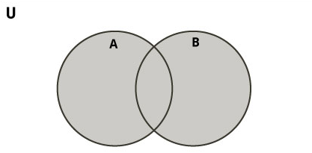
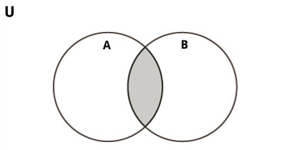
Python Sets
Set Operations:
Set Union
Set Intersection

Slide 105
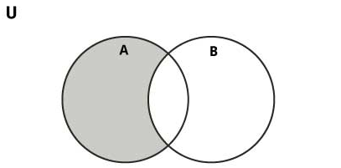
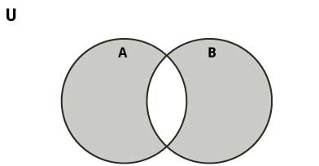
Python Sets
Set Operations (Contd.):
Set Difference
Set Symmetric Difference

Slide 106
Python Sets
Python Set Methods:
add() - Add an element to a set
clear() - Remove all elements form a set
copy() - Return a shallow copy of a set
difference() - Return the difference of two or more sets as a new set
difference_update() - Remove all elements of another set from this set
discard() - Remove an element from set if it is a member. (Do nothing if the element is not in set)
intersection() - Return the intersection of two sets as a new set
intersection_update() - Update the set with the intersection of itself and another
isdisjoint() - Return True if two sets have a null intersection
issubset() - Return True if another set contains this set

Slide 107
Python Sets
Python Set Methods (Contd.):
issuperset() - Return True if this set contains another set
pop() - Remove and return an arbitrary set element. Raise KeyError if the set is empty
remove() - Remove an element from a set. If the element is not a member, raise a KeyError
symmetric_difference() - Return the symmetric difference of two sets as a new set
symmetric_difference_update() - Update a set with the symmetric difference of itself and another
union() - Return the union of sets in a new set
update() - Update a set with the union of itself and others

Slide 108
Python Sets
Python Built-in Functions with Set:
all() - Return True if all elements of the set are true (or if the set is empty).
any() - Return True if any element of the set is true. If the set is empty, return False.
enumerate() - Return an enumerate object. It contains the index and value of all the items of set as a pair.
len() - Return the length (the number of items) in the set.
max() - Return the largest item in the set.
min() - Return the smallest item in the set.
sorted() - Return a new sorted list from elements in the set(does not sort the set itself).
sum() - Return the sum of all elements in the set.
Let us go for a demonstration…

Slide 109
Python Essentials
Python Dictionary

Slide 110
Python Dictionary
In Python, Dictionary is an unordered collection of items. While other compound data types have only value as an element, a dictionary has a key: value pair.
Dictionaries are optimized to retrieve values when the key is known.
Example:
my_dict1 = {1: ‘red', 2: ‘yellow‘, 3: ’violet’}
my_dict2 = {'name': ‘Tridib', 'age': 35, 'address': ‘Kolkata'}

Slide 111
Python Dictionary Methods
Method | Description
clear() | Remove all items form the dictionary.
copy() | Return a shallow copy of the dictionary.
fromkeys(seq[, v]) | Return a new dictionary with keys from seq and value equal to v (defaults to None).
get(key[,d]) | Return the value of key. If key doesnot exit, return d (defaults to None).
items() | Return a new view of the dictionary's items (key, value).
keys() | Return a new view of the dictionary's keys.
pop(key[,d]) | Remove the item with key and return its value or d if key is not found. If d is not provided and key is not found, raises KeyError.
popitem() | Remove and return an arbitary item (key, value). Raises KeyError if the dictionary is empty.
setdefault(key[,d]) | If key is in the dictionary, return its value. If not, insert key with a value of d and return d (defaults to None).
update([other]) | Update the dictionary with the key/value pairs from other, overwriting existing keys.
values() | Return a new view of the dictionary's values

Slide 112
Python Essentials
Python Nested Dictionary Implementation

Slide 113
Python Nested Dictionary Implementation
In Python, a nested dictionary is a dictionary inside a dictionary. It's a collection of dictionaries into one single dictionary.
Example:
people = {
1: {'name': ‘Agnibha', 'age': '21', 'sex': 'M'},
2: {'name': ‘Titli', 'age': ‘14', 'sex': 'F'},
3: {'name': ‘Diya', 'age': ‘16', 'sex': 'F', 'married': 'No'},
4: {'name': ‘Disha', 'age': ‘32', 'sex': ‘F', 'married': 'Yes'}}
Let us go for a demonstration…

Slide 114
Python Essentials
Python Arrays Implementation

Slide 115
Python Arrays Implementation
Arrays are fundamental part of most programming languages. It is the collection of elements of a single data type, e.g. array of int, array of string.
Let us go for a demonstration…
Methods | Functions
append() | to add element to the end of the list
extend() | to extend all elements of a list to the another list
insert() | to insert an element at the another index
remove() | to remove an element from the list
pop() | to remove elements return element at the given index
clear() | to remove all elements from the list
index() | to return the index of the first matched element
count() | to count of number of elements passed as an argument
sort() | to sort the elements in ascending order by default
reverse() | to reverse order element in a list
copy() | to return a copy of elements in a list

Slide 116
Python Essentials
Python Matrix Implementation

Slide 117
Python Essentials
Python List Comprehension

Slide 118
Python Essentials
File Read and Write Operations

Slide 119
File Read and Write Operations
What is a data file?
File is a logical unit of related information stored on a named location on disk. It is used to permanently store data in a non-volatile memory (e.g. hard disk).
Since, random access memory (RAM) is volatile, so it can’t be treated for permanent storage of data.
When we want to read from or write to a file we need to open it first. When we are done, it needs to be closed, so that resources that are tied with the file are freed.
Hence, in Python, a file operation takes place in the following sequence –
Open a file
Read or write (perform operation)
Close the file

Slide 120
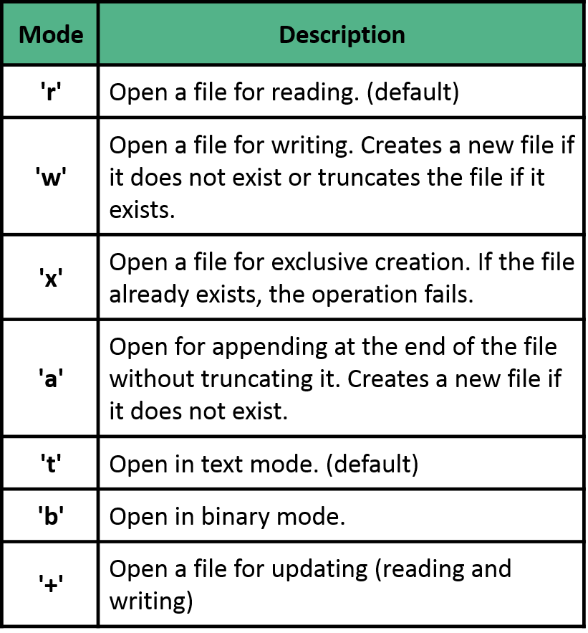
File Read and Write Operations
Python file modes are –
Sample codes –
f1 = open("employee.dat") # equivalent to 'r' or 'rt'
f2 = open("pic.jpg",'r+b') # read and write in binary mode
f3 = open("score.txt",'w') # write in text mode

Slide 121
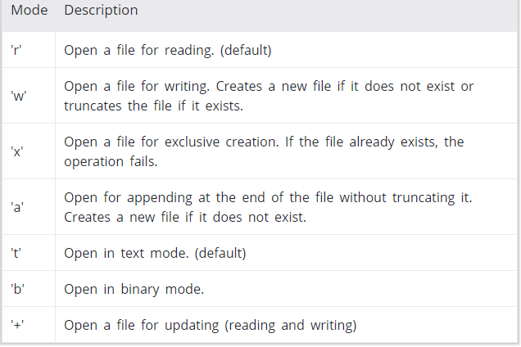
Mode | Description
'r' | Open a file for reading. (default)
'w' | Open a file for writing. Creates a new file if it does not exist or truncates the file if it exists.
'x' | Open a file for exclusive creation. If the file already exists, the operation fails.
'a' | Open for appending at the end of the file without truncating it. Creates a new file if it does not exist.
't' | Open in text mode. (default)
'b' | Open in binary mode.
'+' | Open a file for updating (reading and writing)
File Read and Write Operations
Python file modes are –
Sample codes –
f1 = open(“employee.dat") # equivalent to 'r' or 'rt'
f2 = open(“pic.jpg",'r+b') # read and write in binary mode
f3 = open(“score.txt",'w') # write in text mode

Slide 122
File Read and Write Operations
Closing a file in Python –
When we are done with operations to the file, we need to properly close the file.
Closing a file will free up the resources that were tied with the file and is done using Python close() method.
Python has a garbage collector to clean up unreferenced objects but, we must not rely on it to close the file.
f = open("employee.dat", encoding = 'utf-8')
# perform file operations
f.close()

Slide 123
Python Essentials
File Read and Write Operations - Example

Slide 124
File Read and Write Operations
Closing a file in Python –
A safer way is to use a try...finally block.
try:
f = open("employee.dat",encoding = 'utf-8')
# perform file operations
finally:
f.close()
This way, we are guaranteed that the file is properly closed even if an exception is raised, causing program flow to stop.
The best way to do this is using the with statement. This ensures that the file is closed when the block inside with is exited without explicitly calling the close() method.
with open("test.txt",encoding = 'utf-8') as f:
# perform file operations
Let us go for a demonstration…

Slide 125
Python Essentials
File Methods in Python

Slide 126
File Methods in Python
Python file Methods
Method | Description
close() | Close an open file. It has no effect if the file is already closed.
detach() | Separate the underlying binary buffer from the TextIOBase and return it.
fileno() | Return an integer number (file descriptor) of the file.
flush() | Flush the write buffer of the file stream.
isatty() | Return True if the file stream is interactive.
read(n) | Read atmost n characters form the file. Reads till end of file if it is negative or None.
readable() | Returns True if the file stream can be read from.
readline(n=-1) | Read and return one line from the file. Reads in at most n bytes if specified.

Slide 127
File Methods in Python
Python files Methods (Contd.)
Method | Description
readlines(n=-1) | Read and return a list of lines from the file. Reads in at most nbytes/characters if specified.
seek(offset,from=SEEK_SET) | Change the file position to offset bytes, in reference to from (start, current, end).
seekable() | Returns True if the file stream supports random access.
tell() | Returns the current file location.
truncate(size=None) | Resize the file stream to size bytes. If size is not specified, resize to current location.
writable() | Returns True if the file stream can be written to.
write(s) | Write string s to the file and return the number of characters written.
writelines(lines) | Write a list of lines to the file.

Slide 128
File Methods in Python
Python files Methods (Contd.)
Method | Description
readline(n=.1) | Read and return one line from the file. Reads in at most n bytes if specified.
readlines(n=.1) | Read and return a list of lines from the file. Reads in at most n bytes/characters if specified.
seek(offset,from=SEEK,SET) | Change the file position to offset bytes, in reference to from (start, current, end.)
seekable() | Return True if the file stream supports random access.
tell() | Returns the current file location.
truncate(size=none) | Resize the file stream to size bytes. If size is not specified, resize to current location.
writable() | Returns True if the file stream can be written to.
write(s) | Write string s to the file and return the number of character written.
writelines(lines) | Write a list of lines to the file.

Slide 129
Python Essentials
Python Directory and File Management

Slide 130
Python Directory and File Management
If there are a large number of files to handle in your Python program, we can arrange our code within different directories to make things more manageable and reachable.
A directory or folder is a collection of or set of files and sub directories.
Python has the os module, which provides us with many useful methods to work with directories (and files as well).
Directory management in Python means creating a directory, renaming it, listing all directories and working with them.
Let us go for a demonstration…

Slide 131
Python Essentials
Python Errors and Exceptions

Slide 132
Python Errors
When writing a program and executing it we often encounter errors.
Error caused by not following the proper structure (syntax) of the language is called syntax error or parsing error.
Example – if We miss : in the if statement, if imports are not proper etc.

Slide 133
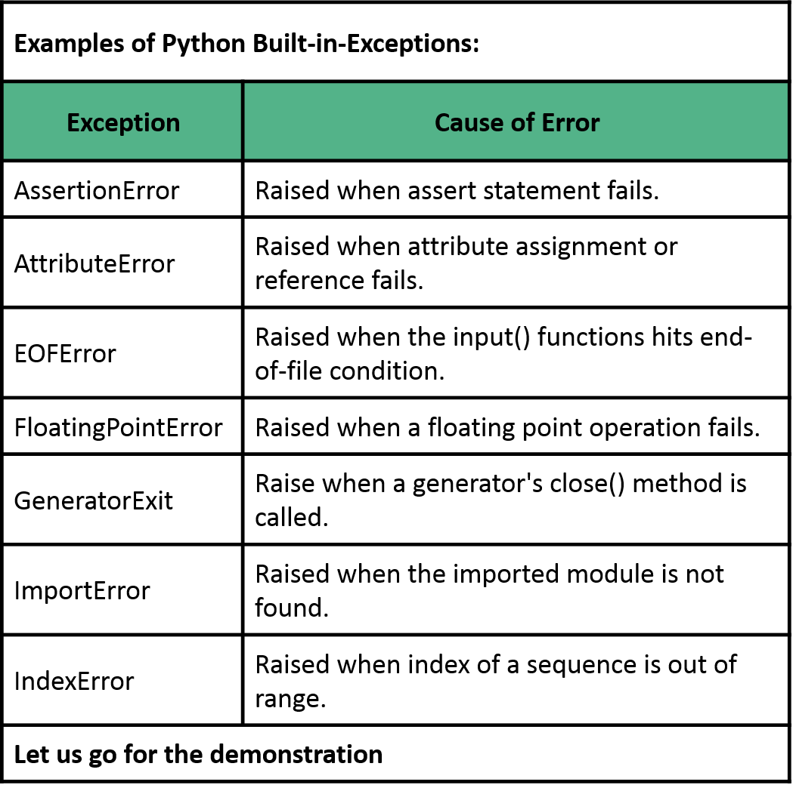
Python Built-in Exceptions

Slide 134
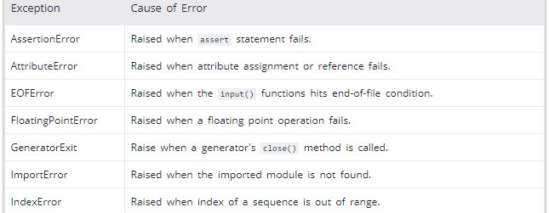
Python Built-in Exceptions
Examples of Python Built-in Exceptions:
Let us go for the demonstration…
Examples of Python Built-in-Exceptions:
Exception | Cause of Error
AssertionError | Raised when assert statement fails.
AttributeError | Raised when attribute assignment or reference fails.
EOFError | Raised when the input() functions hits end-of-file condition.
FloatingPointError | Raised when a floating point operation fails.
GeneratorExit | Raise when a generator's close() method is called.
ImportError | Raised when the imported module is not found.
IndexError | Raised when index of a sequence is out of range.
Let us go for the demonstration

Slide 135
Python Essentials
Python Exception Handling - Try, Except and Finally

Slide 136
Python Exception Handling - Try, Except and Finally
Python has many built-in exceptions which enables our program to output an error message when something in it goes wrong.
When these exceptions occur, it causes the current process to stop and passes it to the calling process until it is handled. If not handled, our program will crash.
Let us go for a demonstration…

Slide 137
Python Essentials
User-Defined Exception

Slide 138
Python Essentials
Python OOP Approach

Slide 139
Python OOP Approach
Python is a multi-paradigm programming language as it supports different programming approach. One of the popular approaches to solve a programming problem is by creating objects. This is known as Object-Oriented Programming (OOP).
An object has two characteristics:
Attributes or messages
Behaviors or methods

Slide 140
Python OOP Approach
Let's take an example:
Dog is an object, as it has
name, age, height, weight, color are attributes
barking, wagging, running are behaviors
The concept of OOP in Python focuses on creating reusable code. This concept is also known as DRY (Don't Repeat Yourself).

Slide 141
Python OOP Approach
In Python, the concept of OOP follows some basic principles:
Inheritance – A process of using details from a new class without modifying existing class.
Encapsulation – Hiding the private details of a class from other objects.
Polymorphism – A concept of using common operation in different ways for different data input.
Let us go for demonstration…

Slide 142
Python Essentials
Python Class and Objects

Slide 143
Python Class and Objects
Python is an OOP language. Object is simply a collection of data (variables) and methods (functions) that act on those data. And, class is a blueprint for the object.
An object is also called an instance of a class and the process of creating this object is called instantiation.
Let us go for a demonstration...

Slide 144
Python Essentials
Python Inheritance

Slide 145
Python Inheritance
It refers to defining a new class with little or no modification to an existing class. The new class is called derived (or child) class and the one from which it inherits is called the base (or parent) class.
Let us go for the demonstration…
A
A
B
A
B
C
B
C
D
(a) Single inheritance
(b) Multiple inheritance
(c) Hierarchical inheritance
A
A
B
B
C
C
D
(d) Multilevel inheritance
(e) Hybrid inheritance

Slide 146
Python Essentials
Python Multiple Inheritance

Slide 147
Python Multiple Inheritance
Like C++, a class can be derived from more than one base classes in Python. This is called multiple inheritance.
In multiple inheritance, the features of all the base classes are inherited into the derived class. The syntax for multiple inheritance is similar to single inheritance.
Let us go for the demonstration…
Feature 1
Feature 2
Feature 3
Feature 4
Feature 1
Feature 2
Feature 3
Feature 4
Feature 5

Slide 148
Python Essentials
Python Operator Overloading

Slide 149
Python Operator Overloading
Python operators work for built-in classes. But same operator behaves differently with different types. For example, the + operator will, perform arithmetic addition on two numbers, merge two lists and concatenate two strings.
This feature in Python, that allows same operator to have different meaning according to the context is called operator overloading.

Slide 150
Python Operator Overloading
Operator Overloading Special Functions in Python
Operator | Expression | Internally
Addition | p1 + p2 | p1.__add__(p2)
Subtraction | p1 - p2 | p1.__sub__(p2)
Multiplication | p1 * p2 | p1.__mul__(p2)
Power | p1 ** p2 | p1.__pow__(p2)
Division | p1 / p2 | p1.__truediv__(p2)
Floor Division | p1 // p2 | p1.__floordiv__(p2)
Remainder (modulo) | p1 % p2 | p1.__mod__(p2)
Bitwise Left Shift | p1 << p2 | p1.__lshift__(p2)
Bitwise Right Shift | p1 >> p2 | p1.__rshift__(p2)
Bitwise AND | p1 & p2 | p1.__and__(p2)
Bitwise OR | p1 | p2 | p1.__or__(p2)
Bitwise XOR | p1 ^ p2 | p1.__xor__(p2)
Bitwise NOT | ~p1 | p1.__invert__()

Slide 151
Python Operator Overloading
Comparison Operator Overloading in Python
Operator | Expression | Internally
Less than | p1 < p2 | p1.__lt__(p2)
Less than or equal to | p1 <= p2 | p1.__le__(p2)
Equal to | p1 == p2 | p1.__eq__(p2)
Not equal to | p1 != p2 | p1.__ne__(p2)
Greater than | p1 > p2 | p1.__gt__(p2)
Greater than or equal to | p1 >= p2 | p1.__ge__(p2)
Let us go for a demonstration…

Slide 152
Python Essentials
Python Iterators

Slide 153
Python Iterators
Iterators are present in Python. They are mostly implemented within for loops, comprehensions, generators etc. but hidden in plain sight.
Iterator in Python is simply an object that can be iterated upon. An object which will return data, one element at a time.
Technically speaking, Python iterator object must implement two special methods, __iter__() and __next__(), collectively called the iterator protocol.

Slide 154
Python Iterators
An object is called iterable if we can get an iterator from it. Most of built-in containers in Python like: list, tuple, string etc. are iterables.
The iter() function (which in turn calls the __iter__() method) returns an iterator from them. The __next__() method must return the next item in the sequence. On reaching the end, and in subsequent calls, it must raise StopIteration.
Let us go for the demonstration…

Slide 155
Python Essentials
Python Generators

Slide 156
Python Generators
Why Generators?
Iterators in Python incur lots of overheads. Implementing a class with __iter__() and __next__() method, then keeping track of internal states, raise StopIteration when there was no values to be returned etc.
This is both lengthy and counter intuitive. Generator comes with more simplycities.
Python generators are a simple way of creating iterators. All the overhead we mentioned above are automatically handled by generators in Python.
Simply speaking, a generator is a function that returns an object (iterator) which we can iterate over (one value at a time).

Slide 157
Python Generators
Differences between Generator function and a Normal function:
Generator function contains one or more yield statement.
When called, it returns an object (iterator) but does not start execution immediately.
Methods like __iter__() and __next__() are implemented automatically. So we can iterate through the items using next().
Once the function yields, the function is paused and the control is transferred to the caller.
Local variables and their states are remembered between successive calls.
Finally, when the function terminates, StopIteration is raised automatically on further calls.
Let us go for a demonstration…

Slide 158
Python Essentials
Python Closures

Slide 159
Python Closures
A Closure is a function object that remembers values in enclosing scopes even if they are not present in memory.
Let us go for the demonstration…

Slide 160
Python Essentials
Python Decorators

Slide 161
Python Decorators
Python has an additional and interesting feature called decorators to add functionality to an existing code.
This is also called metaprogramming as a part of the program tries to modify another part of the program at compile time.
Let us go for the demonstration...

Slide 162
Python Essentials
Python Shallow and Deep Copy

Slide 163
Python Essentials
Python @property

Slide 164
Python Essentials
Python Assert

Slide 165
Python Assert
Assertions are statements that assert or state a fact confidently in our program. For example, while writing a division function, we're confident the divisor shouldn't be zero, we assert divisor is not equal to zero.
Assertions are simply boolean expressions that checks if the conditions return true or not. If it is true, the program does nothing and move to the next line of code. However, if it's false, the program stops and throws an error.

Slide 166
Python Assert
It is also a debugging tool as it brings the program on halt as soon as any error is occurred and shows on which point of the program error has occurred.
Let us go for the demonstration…
Previous code
True
Assertion condition
False
Program continue to run
Assertion stops the program and gives assertion error

Slide 167
Python Essentials
Python Regular Expressions

